Slide 1

Title: Human Action Recognition on video using Keras( LSTM and CNN)
Presented by: [211FA18094-Madhulatha] Date: [24-05-2024]

Slide 2
PROLOGUE: The main result of the project is to find the Human action recognisation on videos using CNN+LSM Human action recognition in videos is a process where a computer system identifies and classifies various actions performed by individuals in video footage. This task is important in various applications such as video surveillance, human-computer interaction, and video retrieval systems. Convolutional Neural Networks (CNNs) and Long Short-Term Memory (LSTM) networks are two types of neural networks commonly used in this field.

Slide 3
Key contributions of this project A comprehensive framework combining CNN and LSTM for enhanced action recognition. Detailed analysis of spatial and temporal feature integration. Performance evaluation on standard datasets, highlighting the model's robustness and accuracy.

Slide 4
What is Human Action Recognition: Human Action Recognition (HAR) is a field within computer vision and machine learning that focuses on identifying and classifying human actions from video sequences or image data. The objective of HAR is to interpret the actions being performed by individuals in a scene, which can range from simple movements like walking and running to more complex activities such as dancing or interacting with objects.

Slide 5
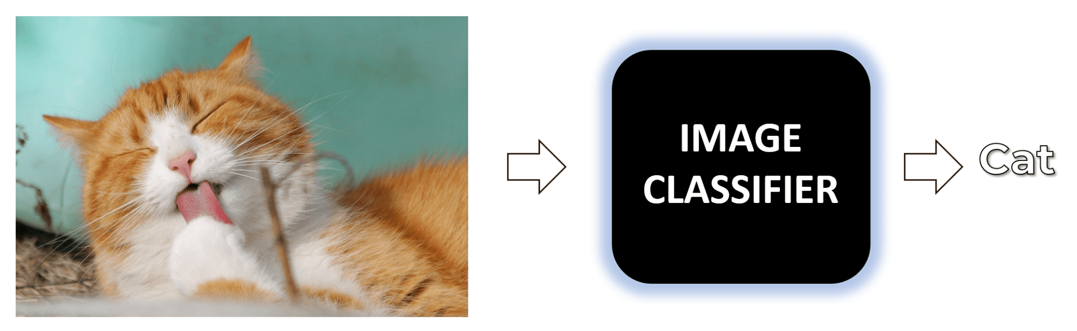
Image Classification: You may already be familiar with an image classification problem, where, you simply pass an image to the classifier (either a trained Deep Neural Network (CNN or an MLP) or a classical classifier) and get the class predictions out of it.

Slide 6
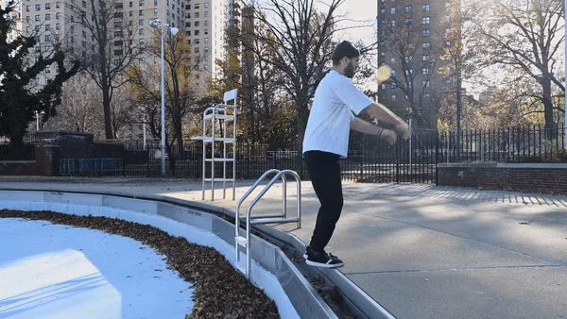
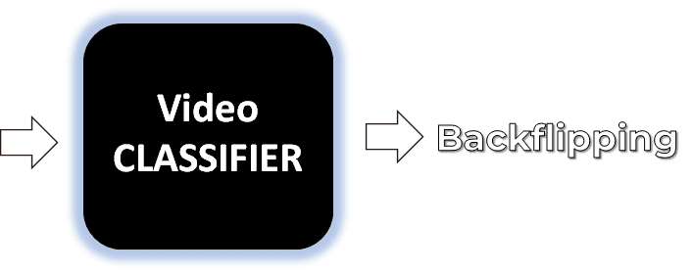
what if you have a video? What will happen then?

Slide 7

But First What Exactly Videos are? Well, so it’s no secret that a video is just a sequence of multiple still images (aka. frames) that are updated really fast creating the appearance of a motion. Consider the video (converted into .gif format) below of a cat jumping on a bookshelf, it is just a combination of 15 different still images that are being updated one after the other.

Slide 8
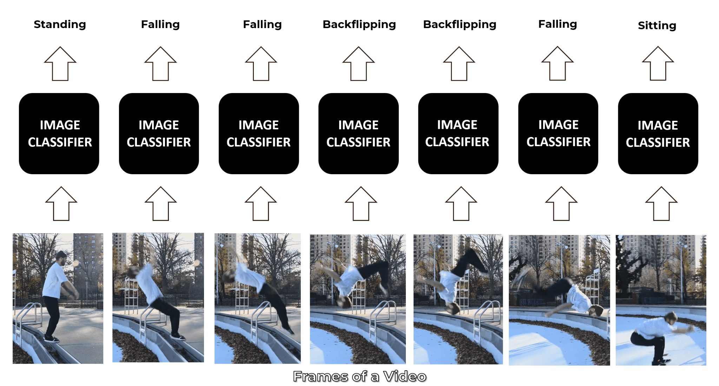
Approach 1: Single-Frame Classification The simplest and most basic way of classifying actions in a video can be using an image classifier on each frame of the video and classify action in each frame independently. So if we implement this approach for a video of a person doing a backflip, we will get the following results.

Slide 9
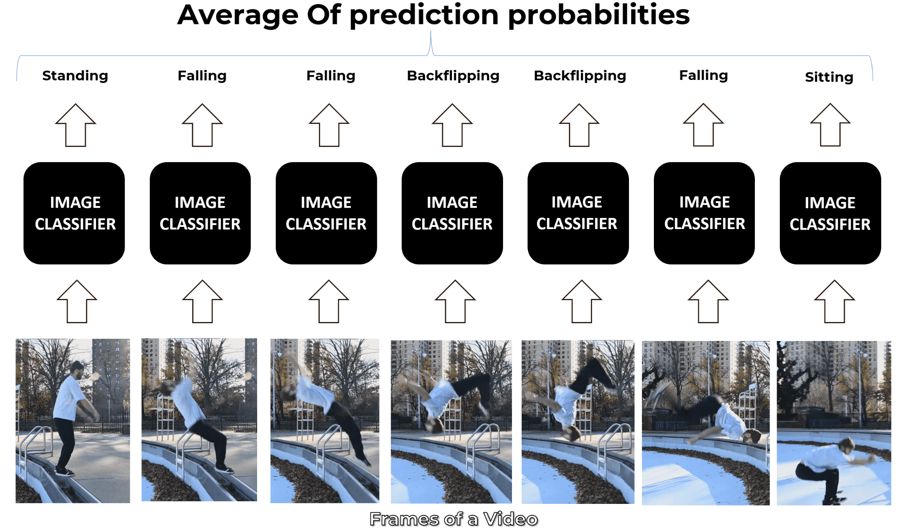
The classifier predicts Falling in some frames instead of Backflipping because this approach ignores the temporal relation of the frames sequence. And even if a person looks at those frames independently he may think that the person is Falling. Now a simple way to get a final prediction for the video is to consider the most frequent one which can work in simple scenarios but is Falling in our case and is not correct. So another way to go about this is to take an average of the probabilities of predictions and get a more robust final prediction.

Slide 10
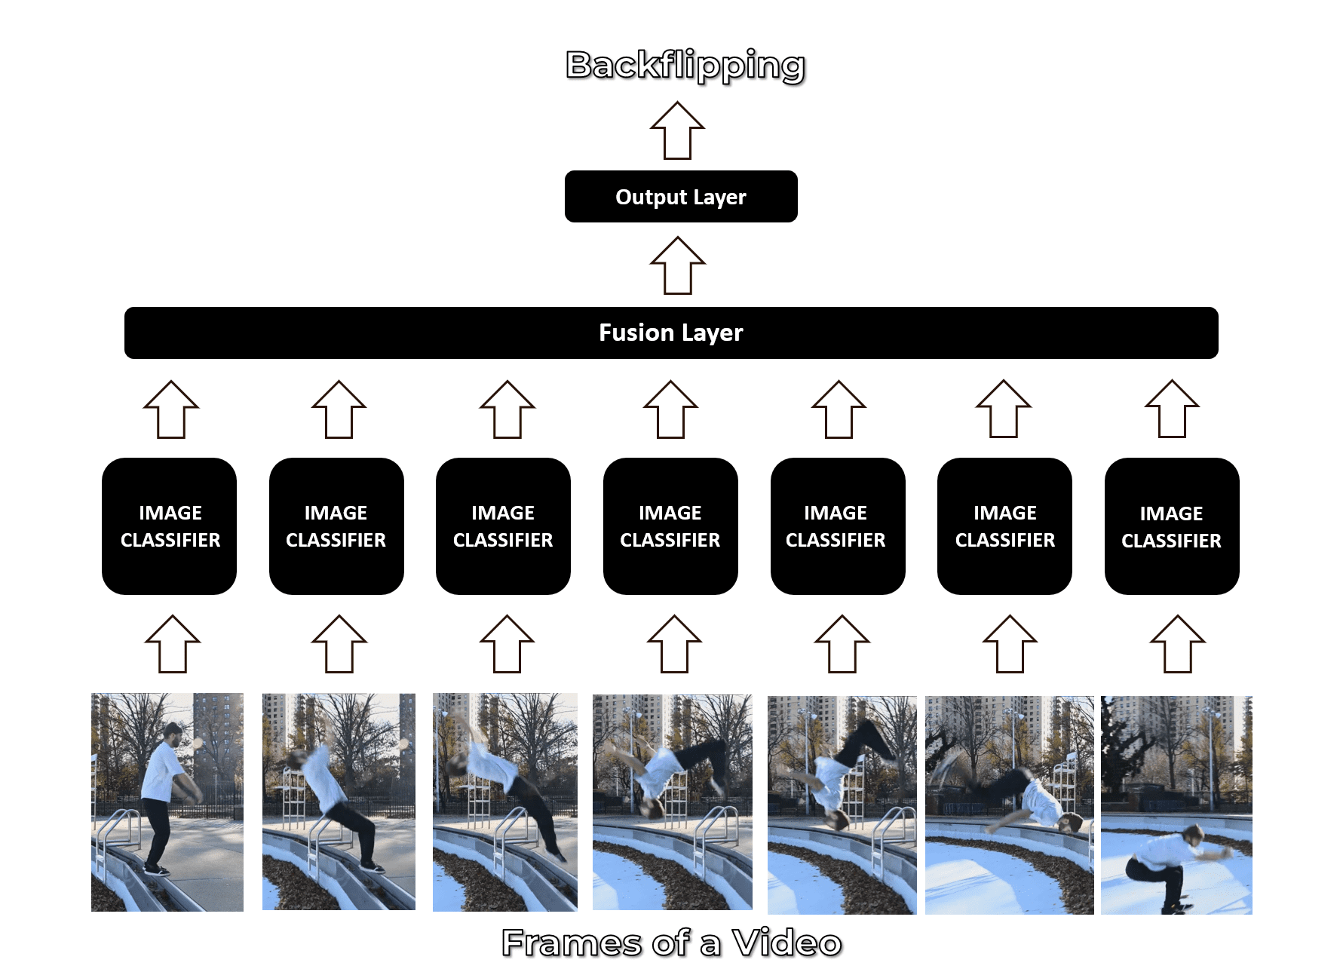
Approach 2: Late Fusion Another slightly different approach is late fusion, in which after performing predictions on each frame independently, the classification results are passed to a fusion layer that merges all the information and makes the prediction. This approach also leverages the temporal information of the data.

Slide 11

Convolutional Neural Network (CNN) A Convolutional Neural Network (CNN or ConvNet) is a type of deep neural network that is specifically designed to work with image data and excels when it comes to analyzing the images and making predictions on them. It works with kernels (called filters) that go over the image and generates feature maps (that represent whether a certain feature is present at a location in the image or not) and initially it generates few feature maps and as we go deeper in the network the number of feature maps is increased and the size of maps is decreased using pooling operations without losing critical information

Slide 12
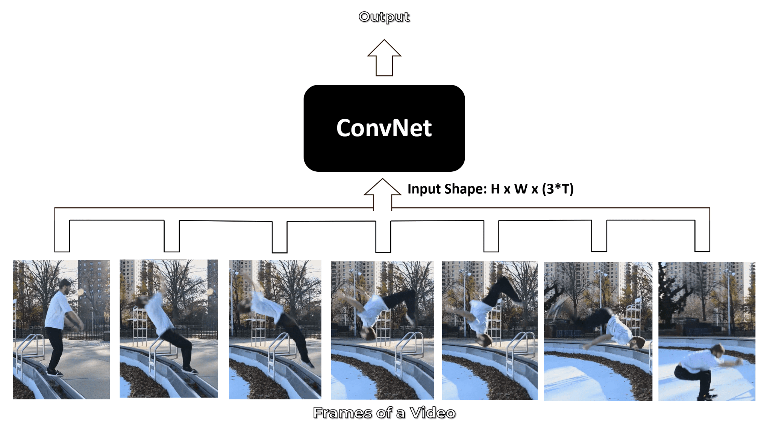
Approach 3: Early Fusion

Slide 13

Approach 4: Using Pose Detection and LSTM Another method is to use a pose detection network on the video to get the landmark coordinates of the person for each frame in the video. And then feed the landmarks to an LSTM Network to predict the activity of the person.

Slide 14
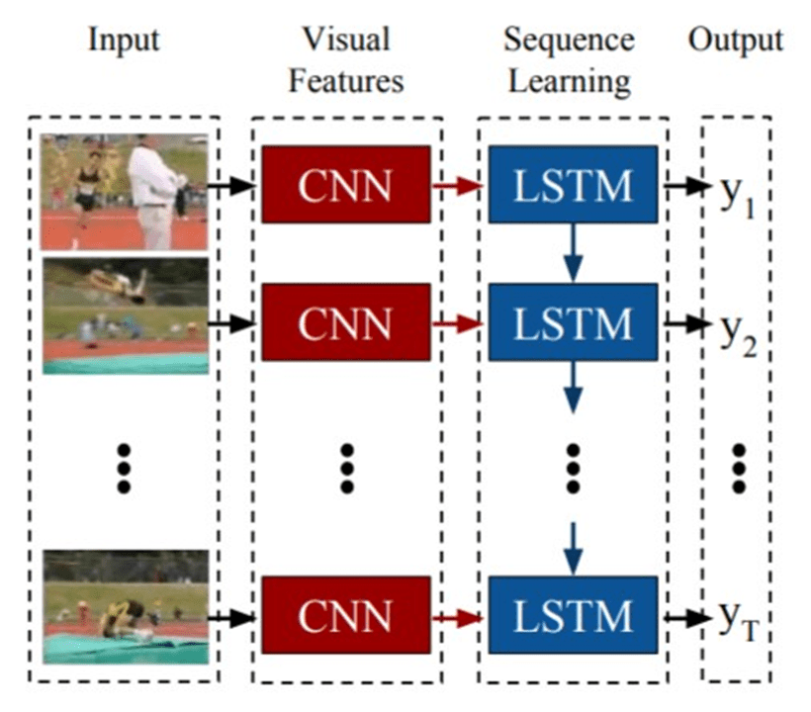
Approach 6: CNN + LSTM: We will be using a CNN to extract spatial features at a given time step in the input sequence (video) and then an LSTM to identify temporal relations between frames.

Slide 15
BASIC STEPS FOR IMPLEMENTING (HAR ): step:1 visualize the Data with its labels. step2: preprocess the Dataset. step3: Split the Data into Train and Test set. Step4: Implement the ConvLSTM Approach. Step5: Implement the LRCN Approach. Step6:Test the Best Performing Model on Youtube Videos

Slide 16
DATA SET : Dataset is taken from “UCF50 is an action recognition data set with 50 action categories, consisting of realistic videos taken from youtube. This data set is an extension of YouTube Action data set (UCF11) which has 11 action categories. Dataset link: “www.crcv.ucf.edu/data/UCF50.rar”

Slide 17

Action Predicted: TaiChi Confidence: 0.94

